Slide 1

ANNAMACHARYA PG COLLEGE OF COMPUTER STUDIES
ONLINE E-LEARN AND EARN
UNDER THE GUIDANCE
OF
SUDHEER BABU SIR
Assistant Professor,
MCA Department.
Presented by
G.RATHNAKISHOR ROLLNO: 185N5F0021, MCA VI Semester, APGCCS, Rajampet

Slide 2
CONTENTS
Data Design(Use ER-Model)
Data Dictionary
UML Design
Use Case Diagram
Class Diagram
Sequence Diagram(s)
Sequence Diagram for Registration
Sequence Diagram for Upload dataset
Sequence Diagram for Graph Construction
Sequence Diagram for Ranking
Activity Diagram(s)
Sequence Diagram for Registration
Sequence Diagram for Upload dataset
Sequence Diagram for Graph Construction
Sequence Diagram for Ranking
Deployment Diagram

Slide 5
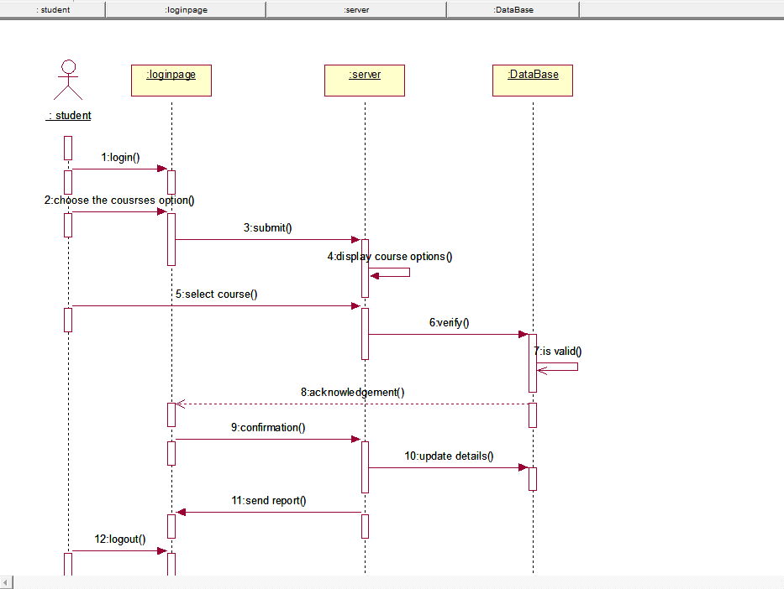
Sequence diagram for
Sequence diagram for select course

Slide 6
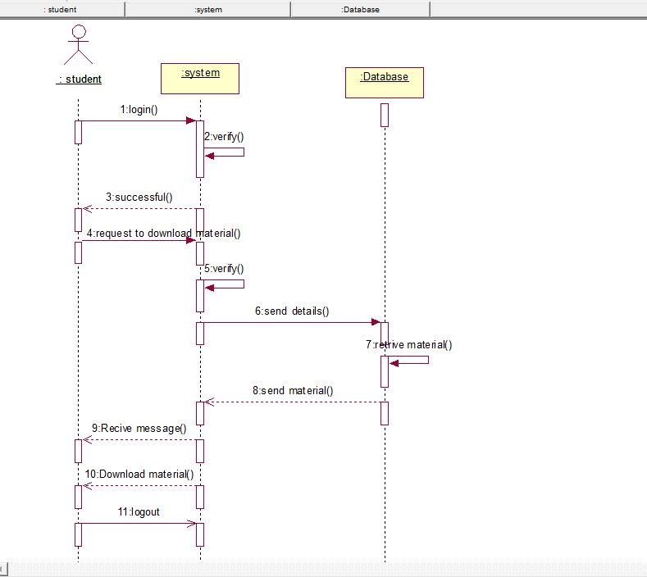
Sequence diagram for download material

Slide 7
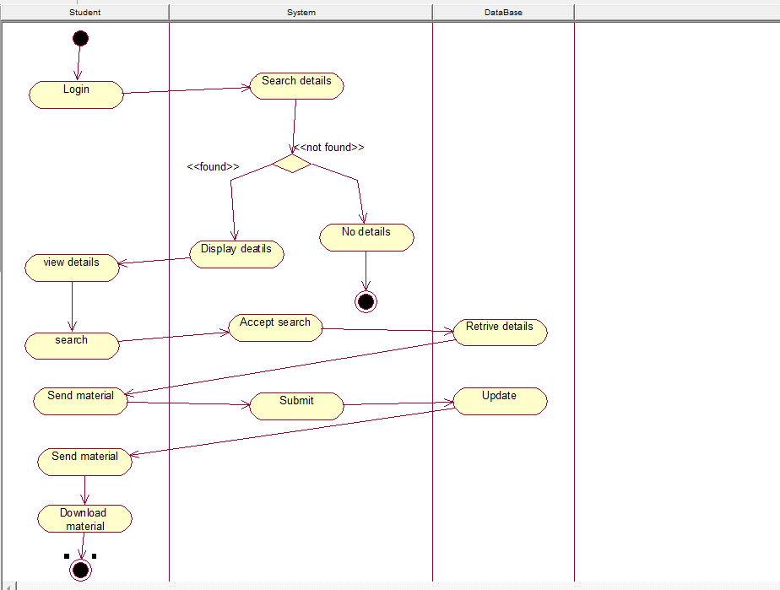
Activity diagram for Download material

Slide 8
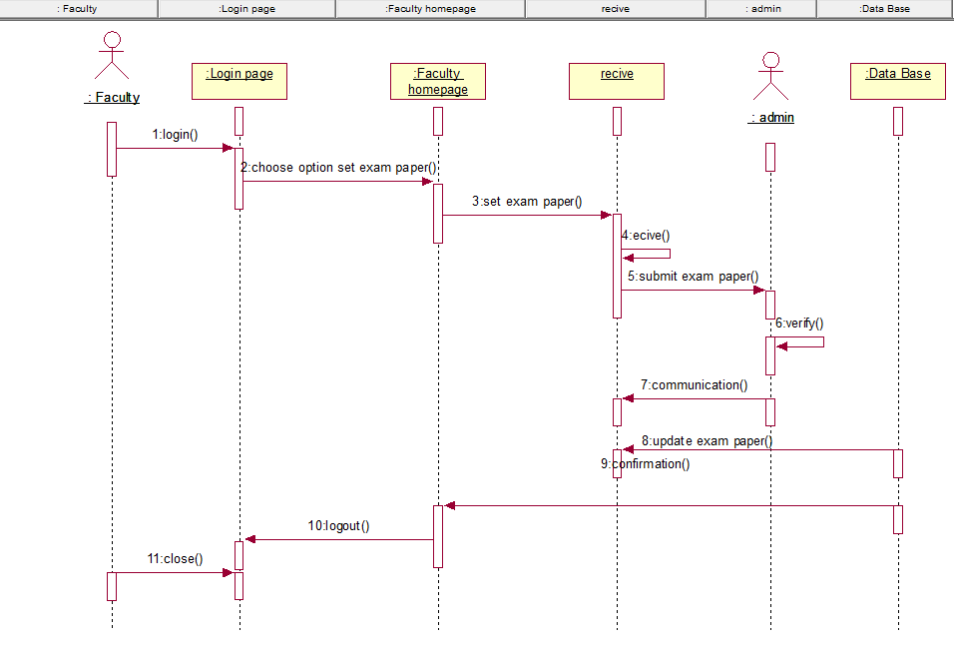
Sequence diagram for set exampaper

Slide 9
Sequence diagram for set exampaper

Slide 10
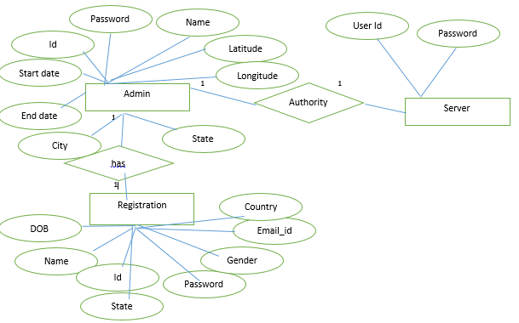
Er model

Slide 11
THANK YOU

